Slide 1
Support Vector Machines (SVM)

Slide 2
SVM
Another supervised algorithm
Widely used in industry and academia
Sometimes more powerful than regression and neural networks with few parameters

Slide 3
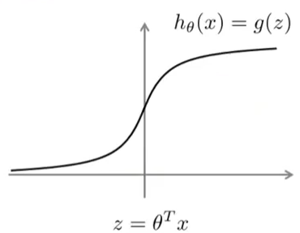
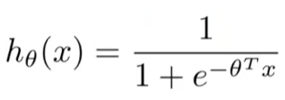
Optimization Objective
Logistic Regression
Logistic Regression Hypothesis
Sigmoid Activation Function

Slide 4

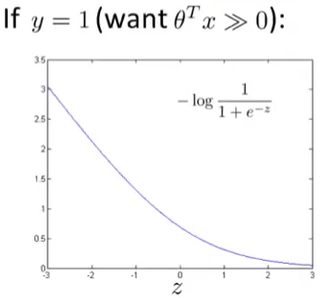
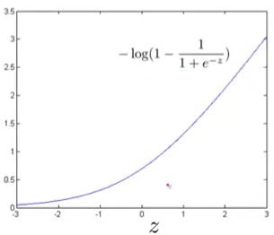
Optimization Objective
For SVM
Cost₁(z)
Cost₀(z)

Slide 5

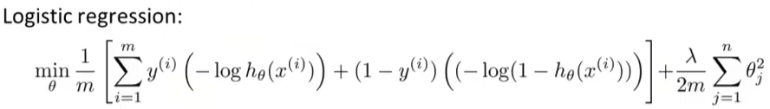

Replace by Cost₁(ϴ^{T}x)
Replace by Cost₀(ϴ^{T}x)
Other changes
Get rid of m, it does not affect minimization
Let A be first term and B to denote regularization term then instead of A+lambda*B, we use CA+B. where C plays same role as lambda.

Slide 6



h_{ϴ}(x) = 1 if ϴ^{T}x>0
0 otherwise

Slide 7

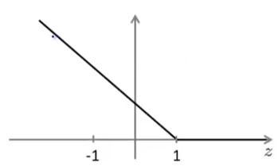
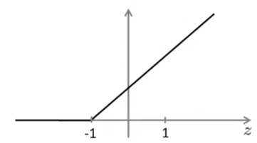

Large Margin Classifier

Slide 8


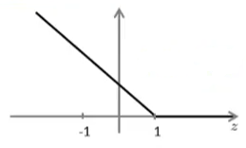


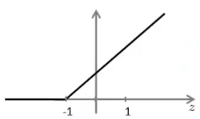
If C is very large, the first term would be chosen to be very low. So how can we make it zero
ϴ^{T}x^{(i)}>1
ϴ^{T}x^{(i)}<-1
*We minimize the first term with the aforementioned constraints

Slide 9
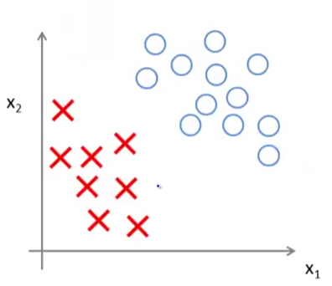

Slide 10
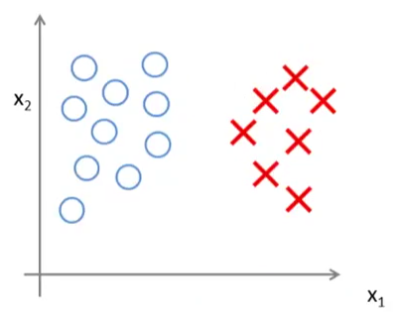

C not too large

Slide 11


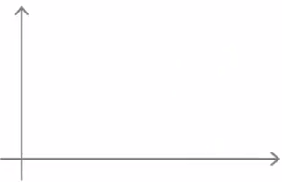
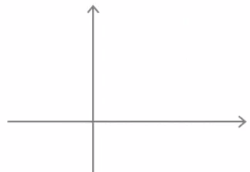
Large Margin Classification Maths
Vector Inner Products
u^{T}v=?
||u|| = Length of vector u
P = projection of vector v on u. It can be +ve or -ve
u^{T}v = u₁v₁ + u₂v₂ = p.||u||
v
u
P
u
v

Slide 12
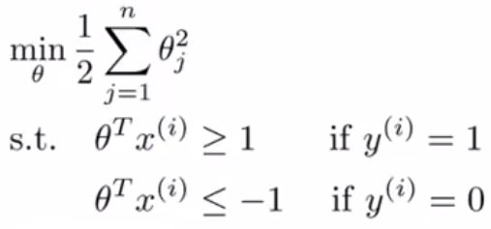

SVM Decision Boundary
=
Simplification: θ₀=0 and n =2
θ^{T}X ←→ u^{T}v
X^{(i)}
θ^{(i)}
P^{(i)}

Slide 13
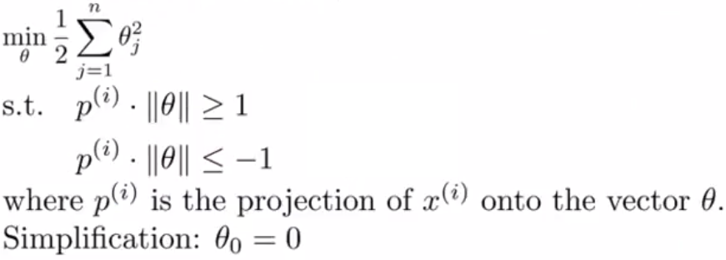
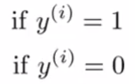
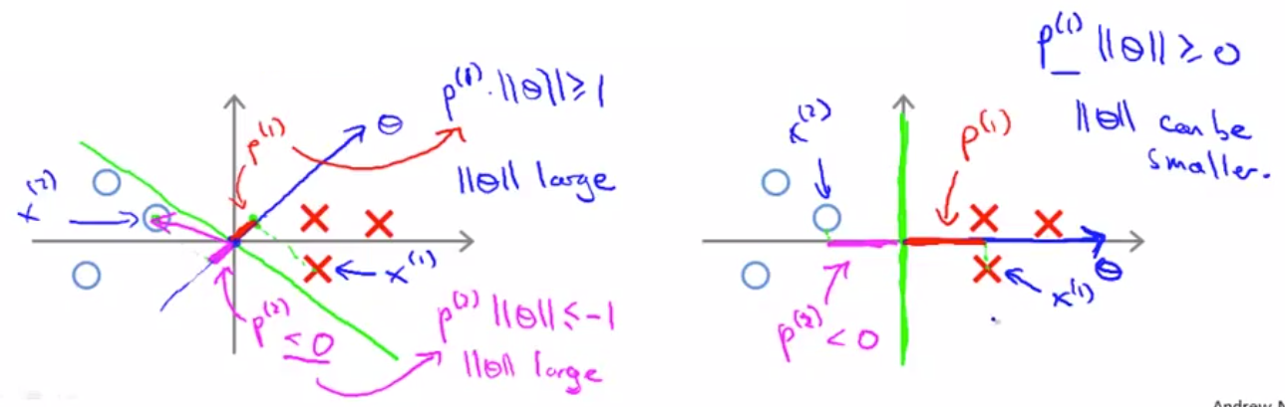
SVM Decision Boundary
=

Slide 14
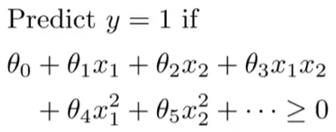
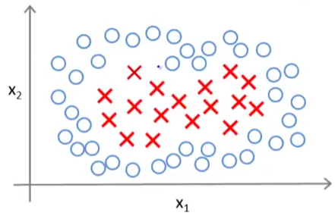
SVM: Kernels
To adapt SVM to non-linear boundaries
Maybe polynomial features like above…..
Is there a different/better set of features?

Slide 15


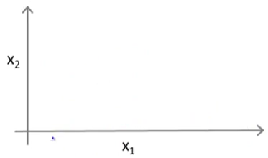
.L⁽¹⁾
.L⁽²⁾
.L⁽³⁾
Given X: f1 =similarity(x,L⁽¹⁾) = exp(-(||x-L⁽¹⁾ ||²)/2σ²
f2 =similarity(x,L⁽²⁾) = exp(-(||x-L⁽²⁾ ||²)/2σ²
f3 =similarity(x,L⁽³⁾) = exp(-(||x-L⁽³⁾ ||²)/2σ²
Kernel (here gaussian)

Slide 16




Numerator will be almost zero, and exponential will be equal to ONE
Numerator will be large, and exponential will be almost ZERO
Each of the landmarks define new features.

Slide 17



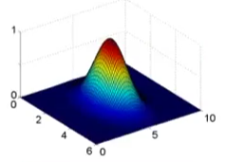
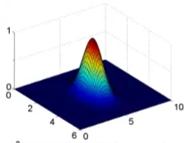
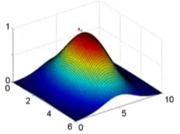


Where is x maximum and minimum?
f1
x1
x2

Slide 18

.L⁽¹⁾
.L⁽²⁾
Predict=1
.L⁽³⁾
Predict=0
Suppose optimal ϴ₀=-0.5, ϴ₁=1, ϴ₂=1, ϴ₃=0
If x is close to L⁽¹⁾ what is output/prediction?
If x is far from all landmarks what is output/prediction?
How do we get these landmarks?

Slide 19

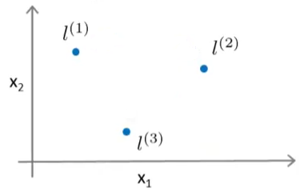
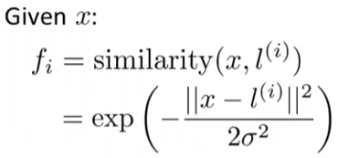

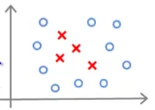
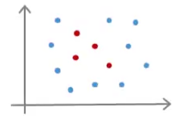

Slide 20
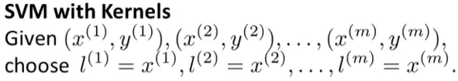


m-features f1 to fm
f₁^{(i)}
f₂^{(i)}
f_{m}^{(i)}
f₁^{(i)} = similarity (x^{(i)},L⁽¹⁾)
f₂^{(i)} = similarity (x^{(i)},L⁽²⁾)
f_{m}^{(i)} = similarity (x^{(i)},L^{(m)})
f^{(i)} =
What is f_{i}^{(i)} ?

Slide 21



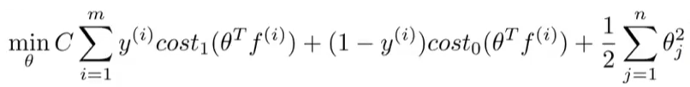
ϴ₀f₀ + ϴ₁f₁ + ϴ₂f₂ +…………+ ϴ_{m}f_{m}
Note here n=m
*Linear and nonlinear kernels directly affect the training time

Slide 22





Slide 23
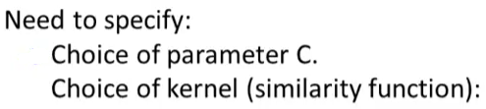

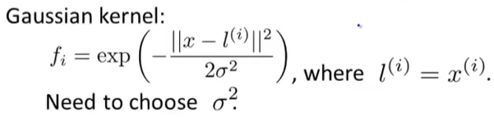
In-Practice
Implementation is not trivial

Slide 24
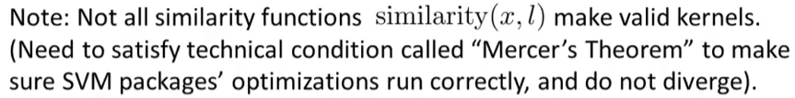
Additional Notes:
Do not forget to perform feature scaling before training a SVM
Linear and Gaussian kernels are most popular
Other choice of kernels
polynomial kernel
Many others….string kernel, chi-square kernel, histogram kernel etc

Slide 25
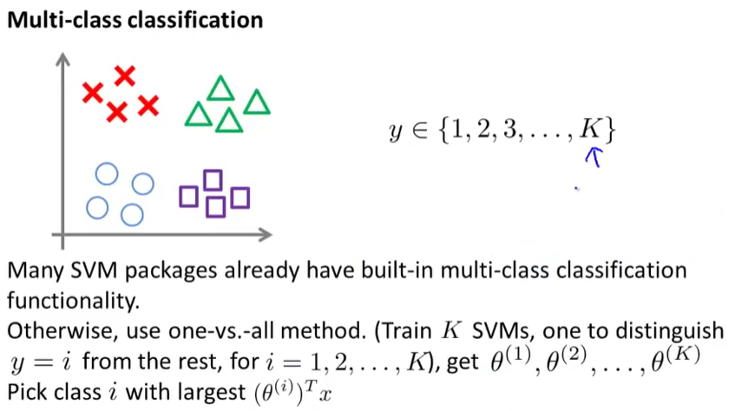

Slide 26

